Slide 1
Leading National Assessment
Naumai, haere mai

Slide 2
Whakataukī

Slide 3
Hei Tīmatanga
Karakia
Housekeeping

Slide 4
Today’s mahi Getting ready for NCEA Change implementation in 2024
NCEA Change Programme –
Internals
New corequisite standards
Pilot and digital standards
External assessment processes
School Review and Readiness Plan

Slide 5
Seminar Programme
8.45 – 10.30am | 10.30 – 11.00am | 11.00 – 12.30pm
NCEA Changes – Policies and practices Corequisites Pilots & Digital External Assessments | PARAMANAWA | 2024 Readiness planning Quality Assurance Updates

Slide 6
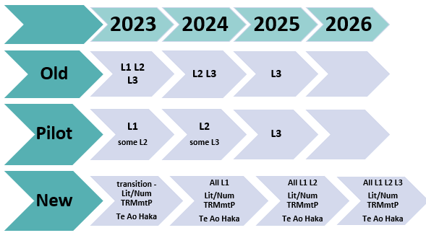
NCEA Changes – a reminder

Slide 7
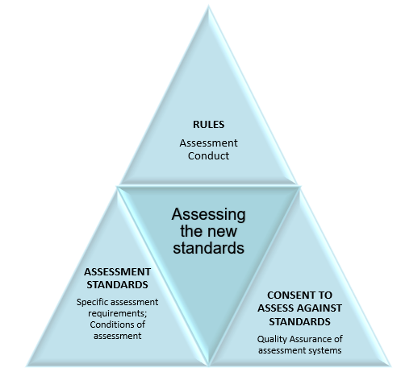
New NZQA Assessment Rules
NZQA has just published new Assessment Rules.
The Rules set out the code of conduct for assessing any standards, including the new Achievement Standards.
Referring to the Rules can be helpful when reviewing
School assessment policies and procedures
Guidelines and expectations for school assessments
The assessment capability of your staff
Complete the activity on page 7

Slide 8
Implications of the new standards

Slide 9
The implications of the new standards
The new standards are different – written for
Accessibility
Mana ōrite me te matauranga Māori
Clearer pathways coherence, credibility, equity and inclusion, and wellbeing
Expect them to be qualitatively different to previous standards in each subject
page 9

Slide 10
For all new Achievement Standards…
Internal assessment provides considerable flexibility in the collection of evidence.
It is recommended that the design of assessment reflects and reinforces the ways students have been learning.
It is also recommended that the collection of evidence for internally assessed Standards should not use the same method that is used for any external Standards in a course, particularly if that method is using a time-bound written examination.
A separate assessment event is not needed for each Standard.
Authenticity of student evidence needs to be assured regardless of the method of collecting evidence. This needs to be in line with school policy.
from ncea.education.govt.nz – each subject, under Assessment.

Slide 11
Activity – get to know a Standard
In your group choose one of the new standards from the New Zealand Curriculum or Te Marautanga o Aotearoa.
Read the assessment specifications and conditions for your chosen standard, and identify and note some implications for assessment policy and practice at your school or kura
Page 10

Slide 12
Getting ready…
How can you be sure that your teachers are ready to assess the new standards, and are ready for any shifts in assessment practice across your school?
How will you prioritise your staff meetings and professional learning time this year to include assessment policy and practice?
Consider the review questions on pages 11 & 12, and add any others for your own school / kura

Slide 13
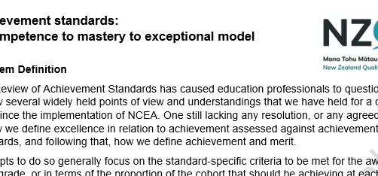
What do Achieved / Merit / Excellence look like? NZQA Discussion Paper

Slide 14
The corequisite standards Te Reo Matatini me te Pāngarau | Literacy and Numeracy Transition page 16

Slide 15
The new corequisite standards
From 2024, the corequisite standards will be required to award an NCEA qualification at any level (excepting transition arrangements)
Consider: How will we know when our students are ready for the corequisite assessments? How will we share monitoring and assessment data across learning areas? How will we get our students ready to sit their first formal digital assessment?

Slide 16
NCEA Literacy and Numeracy requirements in 2023
Literacy options
New standards – Te Reo Matatini OR Literacy
New standards – Pilot standards (temporarily tagged)
Numeracy options
New standards –Pāngarau OR Numeracy
New standards – Pilot standards (temporarily tagged)
Old standards – tagged Literacy list
Old standards – package of Unit Standards
Old standards – tagged Numeracy list
Old standards – package of Unit Standards

Slide 17
The corequisite standards in 2024
Literacy options
New standards – Te Reo Matatini OR Literacy
Numeracy options
New standards – Te Pāngarau OR Numeracy

Slide 18
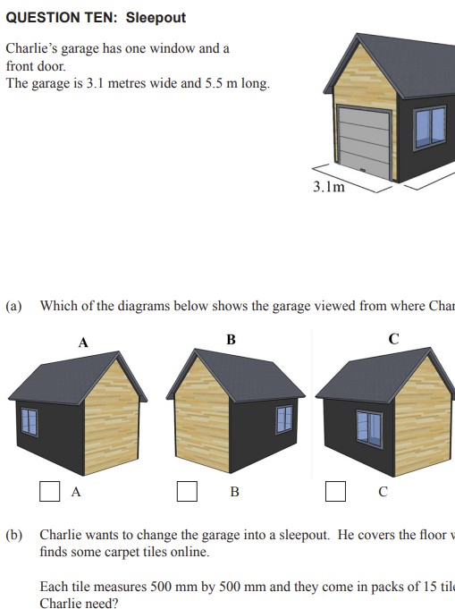
Questions and scenarios for the Transition - Te Reo Matatini me te Pāngarau | Literacy and Numeracy
Read the notes and transition scenarios on pages 18 & 19
What aspects of the Literacy and Numeracy | Te Reo Matatini me te Pāngarau transition will be the most challenging for you, your teachers and students?
What do you need to know?

Slide 19
New, Pilot, transition and digital assessments page 21

Slide 20
Timing of 2023 new external assessments
Note the updates since our seminar last July:
Common Assessment Activities for NZC and TMOA standards don’t start until the end of Term 3 (except Te Ao Haka)
Submissions: Can be submitted whenever they’re ready, but marking won’t begin until after the closing date (25 October) in Term 4

Slide 21
Digital assessments and Assessment Master
Share your experience.
What are your top tips?
What are your next steps?
pages 23 – 25
Complete the survey on p.25

Slide 22
External Assessment – Derived Grades
What has changed?
Terminology – Derived Grades at scale
More and better data
Use of data – follow up expected; DG audits
Activity on page 27

Slide 23
External Assessment - Breaches
What has changed?
Updates to digital breach detection
Preparing for conditions of new standards
Activity on page 30

Slide 24
External Assessment - SAC
What has changed?
Not much yet, but changes coming to align with NCEA Change programme
Keep up with any changes by attending a SAC seminar
page 32

Slide 25
Morning Tea
10.30 – 11.00 am

Slide 26
2024 Readiness Plan – Internal Review page 33

Slide 27
How ready are you for 2024?
How will you ensure that your leaders, teachers, students and whānau are ready?
How will you ensure that your assessment policies and practices are fit for purpose?
How will you get your systems, monitoring and processes ready?

Slide 28
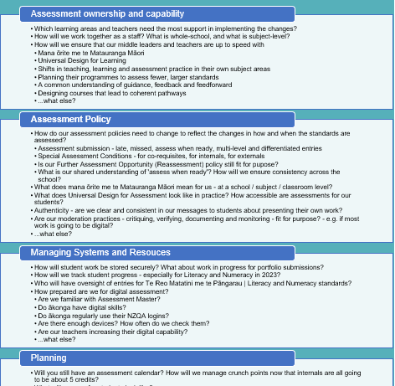
Our 2024 Readiness Plan – next steps:
Read the ideas on page 33.
Highlight / copy / note anything relevant
Discuss at your tables :
Our 2024 Readiness Plan – next steps:
Initial thoughts
Questions
Next steps
page 34

Slide 29
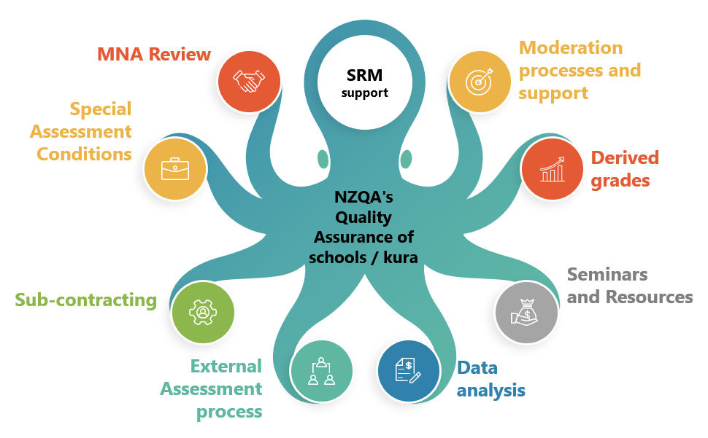
Quality Assurance page 35

Slide 30
Changes to the MNA Review
What’s new?
the implementation of a Model of Continuous Improvement to support schools to enhance their quality assurance processes
the model will help to ensure MNA outcomes are addressed with ongoing support from School Relationship Managers in a timely manner
Considerations / Action Items / Significant Issues
pages 35 - 39

Slide 31
Arotake Pūnaha MNA Hou
The focus of the MNA review is to evaluate how effectively the school ensures the credibility of assessment for national qualifications.
A project has been launched to identify how the MNA process should be managed when working with kura Māori to ensure the MNA process is mana-enhancing and recognises the special character of kaupapa Māori.
Kura will present the evidence of their ongoing Consent to Assess against the NCEA standards consistent with the principles in Te Hono o te Kahurangi framework.

Slide 32
Changes to External Moderation
Changes from 2023
refinements to sample selection for 2023 onwards
Changes from 2024 – new standards
moderation in same year as assessment
one of each new internal each year
two submission deadlines – June & October
Reminders
digital format support available
robust digital storage systems needed page 41

Slide 33
Reminders, Reviews and Updates

Slide 34
Reminders, Reviews, and Updates
It’s all in your emails…
EmaiLink – your regular update from the School Quality Assurance and Liaison team
Assessment Matters – All assessment, operational and logistical matters in relation to secondary qualifications
Derived Grade updates and Special Assessment Conditions updates
page 43

Slide 35
Online support
Assessor Support for Internally-assessed standards
Best Practice Workshops
Bite-size modules & shorter courses
Transforming Assessment Praxis & longer workshops
On request webinars
Face-to-Face support
Regional cluster meetings
Request a speaker – for a regional or national event on an agreed topic
Best Practice Workshops
These are all available on request. Some face-to-face requests are able to be offered free of charge if certain conditions are met.
See: https://www.nzqa.govt.nz/about-us/events/assessor-support/

Slide 36
External Assessment - personalised exam booklets
What has changed?
Students with digital entries for Level 1 standards in 2023 will not be provided with a set of printed and personalised exam booklets. Paper resource booklets will continue to be provided.
page 45

Slide 37
Hei konei ra me ngā mihi
Please complete the evaluation before you leave!
page 46

