Slide 1
Leading National Assessment Seminar
School Quality Assurance and Liaison
Feb – March 2024

Slide 2
Today’s mission
NCEA Change and Implementation
Effective quality assurance
Teacher capability / credible assessment practice

Slide 3
NCEA Change Structure and transition

Slide 4
Old
L2 L3
Pilot
L2
New
L1
L1 L2
Co-requisite
TRM TP | Lit Num
2024
2025
2026
2027
L2 L3
L3
L3
L1 L2 L3
dedicated standards + additional list + previously completed
dedicated standards + additional list + previously completed
dedicated standards + previously completed
dedicated standards
L1
NCEA Change
transition

Slide 6
What is your school or kura doing?
We know that many schools have reconsidered their approach to Level 1 NCEA.
Some have made changes as a result.
What is your school doing and what was the rationale?

Slide 7
NCEA Change The co-requisite
page 6

Slide 8
How the co-requisite works….
Te Pāngarau or Numeracy
No mixing of methods
Te Pāngarau 32412
Numeracy 32406
10 credits of additional standards for Te Pāngarau or Numeracy (including some with usage restrictions)
Completed requirement achieved before 2024 (all 10 credits)
Te Reo Matatini or Literacy
No mixing of methods
Literacy Reading 32403 and Literacy Writing 32405
Te Reo Matatini 32414
10 credits of additional standards for Literacy (including some with usage restrictions)
10 credits of additional standards for Te Reo Matatini
Completed requirement achieved before 2024 (all 10 credits)

Slide 9
2024 dedicated co-requisite standards
Literacy 32403 and 32405
20-31 May
9-20 September
30 October (kete manarua)
Numeracy 32406
20-31 May
9-20 September
Te Reo Matatini 32414
10-21 June
9-20 September
30 October (kete manarua)
Te Pāngarau 32412
10-21 June
9-20 September
page 7

Slide 10
Managing the co-requisite requirement in 2024
Tracking readiness?
Accessing e-asTTle or similar results?
Teaching across the curriculum?
Making entries? Checking entries?
Explaining how it works?
Using the additional standards?
Checking standards with eligibility requirements?
Overseeing transferring students’ readiness?
Monitoring progress?
Compiling strategies for classroom use?
Leading professional learning?
How will your teachers help students to complete the co-requisite requirement?
page 8

Slide 11
Co-requisite transition – questions and scenarios for 2024
Turn to page 10, quick questions – Do you know or can you find? True or False?

Slide 12
New Level One Achievement Standards – Implications for processes, practice and review
See the appendices on pages 34 – 37
These are accurate lists according to the assessment specifications in early February 2024. Keep alert for any changes.

Slide 13
Appendices 5 quick questions There are new L1 standards for 45 subjects
How many 1.4s can be assessed in exams or TAPA? How many 1.3s can be assessed with submissions or kete manarua? How many exams are paper-only? How many subjects can be assessed with 2 submitted standards? Which Learning Area has the most EN2 Mātauranga Māori notes?

Slide 14
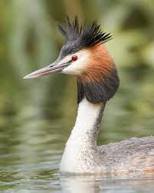
New Level One Achievement standards – implications for your calendar
What are the implications of the Appendices for your: - school calendar? - usual assessment calendar / oversight of timing?

Slide 15
New Level One Achievement standards – implications for school / kura leaders
How do you develop teachers’ assessment practice? What is effective? How do you know?

Slide 16
Teacher assessment capability
Feedback and Feedforward
Conditions of Assessment
Assessment Specifications
Authenticity
Timing
Scaffolding
Internal assessment
External over-time assessment
Purpose
Department processes
Internal moderation
Get an overview
Authenticity
Universal Design for Assessment
How could you use the questions on page 14 to review your school’s implementation of NCEA Changes? What will be your next steps as a school leader?
pages 14-16

Slide 17
Authenticity
Are your authenticity policies up to date? What happens in your school if inauthentic work is discovered or suspected?
pages 17-18

Slide 18
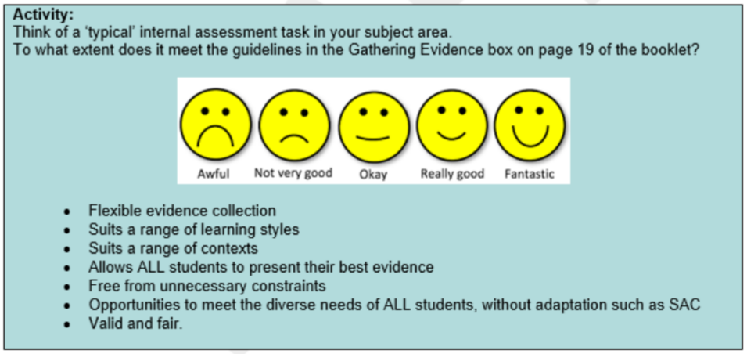
Universal Design for Assessment

Slide 19
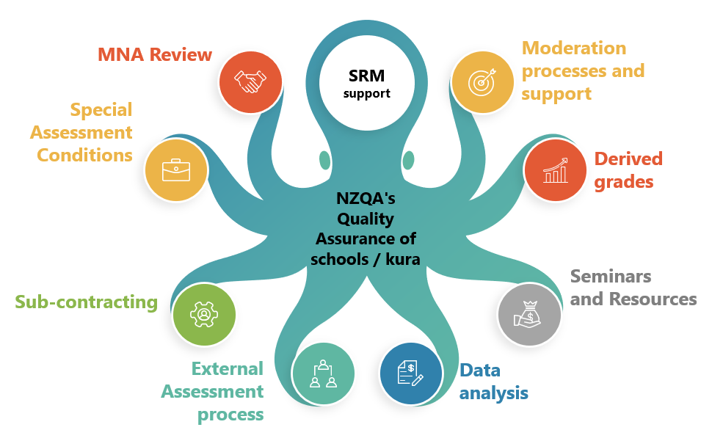
Quality Assurance

Slide 20
Quality assurance - Data
Entry check: Standard number and version Assessment method and opportunity | Common issues: Incorrect assessment opportunity Digital vs Paper
Top tips:
Empower your staff and students!
Put regular checks in your calendar and share
Ensure the accuracy of your data before 1 April, 1 September and 1 December
Share responsibility for checking that practice grades have been submitted to NZQA
GET YOUR ENTRY FILES IN ON TIME
What is your ‘top tip’ for ensuring that entries and results data are accurate?

Slide 21
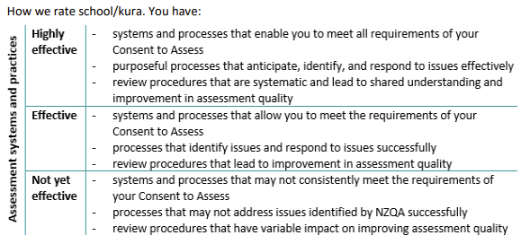
Quality assurance – MNA Reviews
Common agreed actions
External moderation
Internal moderation
Communications
Have you recently reviewed your school / kura practice in the above areas? How are you going? How do you know? What are your next steps?
page 23

Slide 22
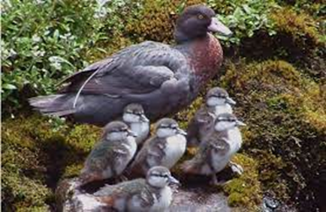
Quality assurance – Internal Moderation
Requirements remain the same!
Assessment material is critiqued before use
Judgements are consistent with the standard
Judgements are verified by another teacher
Materials retained for external moderation
Advice from external moderation actioned before using material again
What will be your challenges in 2024? How will you monitor the monitoring workload?
page 24

Slide 23
External Moderation
Your 2024 moderation plan
Timing – no submission months, submit as soon as it’s ready
Moderation outcomes and next steps
Do now / Plan for
How will you monitor what needs to be sent, when to submit it, and when follow up actions have been completed?

Slide 24
External Assessment processes
page 27

Slide 25
Special Assessment Conditions
Notifications Gateway or Approvals Gateway?
Trial Notification Gateway for new applications attempting Level 1 standards
It’s optional
Applications for Y12 & 13 must go through the Approvals Gateway
Co-requisite only? Application / notification not required – support as appropriate
Do now / Plan for
Decide at senior leadership level if you will use the notification gateway for Level 1 SAC applications in 2024
page 27

Slide 26
Derived Grades
New Level 1 Standards – see Appendix 1
Discontinuing derived grade audits – MNA reviews and school visits
Key points for collecting evidence and quality assurance procedures
How do you track the collection and submission of DGs to NZQA? What needs reviewing and/or improving?
page 28

Slide 27
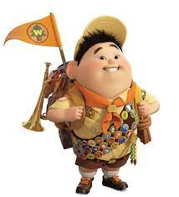
Over-time submissions
Be Prepared!
Get familiar with the assessment specifications
Get familiar with the requirements for administering the assessment
Identify key staff who will be involved with managing the assessment
Discuss: Ideas for managing submission season? Tips from last year?
pages 30-31

Slide 28
Managing the authenticity of submissions
For every submitted standard:
The use of chatbots, generative AI, paraphrasing tools, or other tools that can automatically generate content is not permitted and material generated by these tools should not be submitted as part of the candidate’s work. Teachers must closely supervise the process of evidence collection to ensure that candidates: do not copy from another person or source without appropriate acknowledgement do not receive guidance, scaffolding, instruction, assistance, or assessment conditions beyond what is specified as permissible in these Assessment Specifications Where a teacher cannot verify that the assessment submitted is the authentic work of the candidate, they must notify NZQA of a possible Candidate Breach of External Assessment.

Slide 29
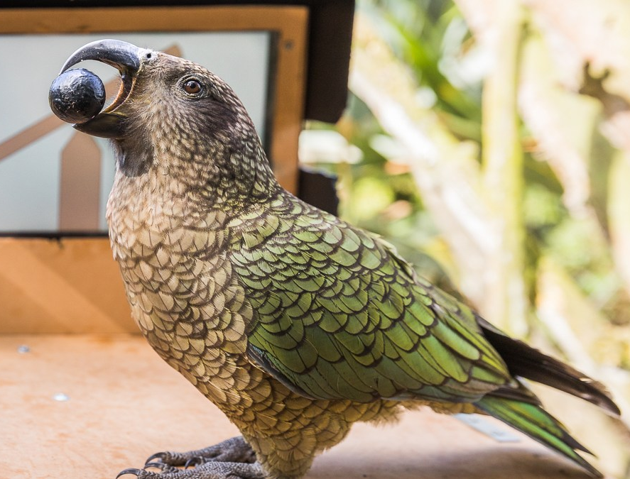
Digital external assessments and exams 2024
The dedicated co-requisite unit standards, most Level 1 exams and some Level 2 and 3 exams will be offered digitally.
NZQA is planning for the large-scale digital assessments at the end of the year.
If the standard is offered digitally, it should be automatically selected when you make an entry in your SMS or Web entries.
You can de-select the digital option and select paper.
Personalised papers will be provided for all exams this year, even if students are entered for the digital option.

Slide 30
Just a couple of reminders…
Learner logins
Any student who had an entry in 2023 can access their NZQA account
Any student who is entered for the first time in 2024 can’t create an NZQA account until after your 1st April file is processed
2. Pūtake
Make sure each teacher has access – check their ESL authorisations
See our Teachers New to NCEA Standards-Based Assessment module
See the assessment practice modules, and digital assessment modules
page 33

Slide 31
Ngā manu
Kererū
Pūteketeke
Kiwi
Kākāriki
Kōtare
Kōtare
Pūteketeke
Tawaki
Real / plastic heihei
Kākā
Korora
Wheke ☺
Tūī
Kārearea
Whio
Kuaka
Takahē
Kea
Tarāpunga
Ruru
pekapeka

Slide 32
Kia ora Thank you
www.nzqa.govt.nz

