Slide 1
Preparing for LIT NUM | TRM TP
Literacy and Numeracy | Te Reo Matatini me te Pāngarau
v 8-MAY-24

Slide 2
Dedicated co-requisite assessment opportunities
Unit Standard | Title | Assessment Session Code | Assessment Opportunity One (AO1) | Assessment Opportunity Two (AO2) | Assessment Opportunity Three (AO3)
US 32403 v2 | Literacy - Reading | LITR | 20th-31st MAY T2 Wk 4-5 | 9th-20th SEPT. T3 Wk 8-9
US 32405 v3 | Literacy - Writing | LITW | 20-31 MAY | T2 Wk 4-5 | 9-20 SEPT. | T3 Wk 8-9
US 32406 v3 | Numeracy | NUME | 20-31 MAY | T2 Wk 4-5 | 9-20 SEPT. | T3 Wk 8-9
US 32413 v1 | Te Reo Torohū | MATT | 10th-21st JUNE T2 Wk 7-8 | 9-20 SEPT. | T3 Wk 8-9 | Kete manarua due 30th OCT.
US 32415 v1 | Te Reo Whakaputa | MATW
US 32412 v2 | Pāngarau | PANG | 10-21 JUNE | T2 Wk 7-8 | 9-20 SEPT. | T3 Wk 8-9

Slide 3
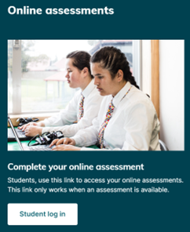
LIT NUM | TRM TP assessment information
Common Assessment Activities (CAAs) and Tūmahi Aromatawai Pātahi (TAPA) are online assessments delivered on a digital assessment platform
The assessments are not time bound but a student who has control of curriculum level 4 should complete in sixty minutes
Each assessment must be completed within a single supervised session
Further detailed information is available on the MoE and NZQA websites

Slide 4
Special Assessment Conditions
An application for Special Assessment Conditions (SAC) is not required for the dedicated co-requisite assessments – schools decide the support needed for each student
Polly (text-to-speech tool ) will be available in the Literacy Writing (32405) and Numeracy (32406) digital assessments
Contact sac@nzqa.govt.nz for specific advice.

Slide 5
Seven steps to get your school ready for
LIT NUM | TRM TP in Term 2
School-wide planning
Accurate NCEA entries
MyNZQA learner accounts setup
Student preparation
Assessment Master (AM)
Technical preparation
Contingency plans

Slide 6
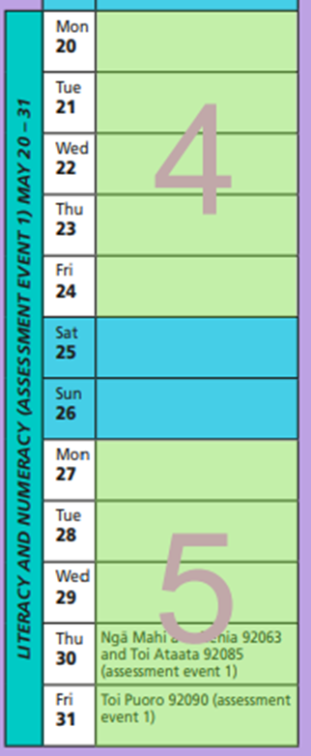
School-wide planning
‘Assess when ready’ means a student has control of curriculum level 4 and is ready to work at level 5.
Make a plan that meets the needs of your students.
Check your school calendar and book venues if necessary
Meet with key staff e.g. IT support, AP/DP Day-to-day Operations, database manager, learning support coordinator for students with SAC.
Not time bound but should take 60mins - plan for 90mins
One supervisor per classroom or three for a full hall – one digital and two roaming

Slide 7
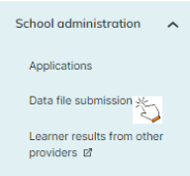
Accurate entries
Enter students into standards via your SMS or Web Entries. Ensure the correct Assessment Opportunity (AO) is selected. AO1 is the first assessment event in the year which is not necessarily the first time the student does it. Once your entries are processed, check for warnings or errors and fix them. Contact your School Relationship Manager (SRM) or
schools@nzqa.govt.nz for data processing issues.
Check that the method is ‘digital’ so that the entries will flow into the assessment platform.
Sort Codes – check with your SMS provider if you have options to add Sort Code information to your entries which can then help with filtering and rooming.
Data is required on or around the first of each month (starting 1st April). Data can be sent more frequently to keep it current with NZQA.

Slide 8
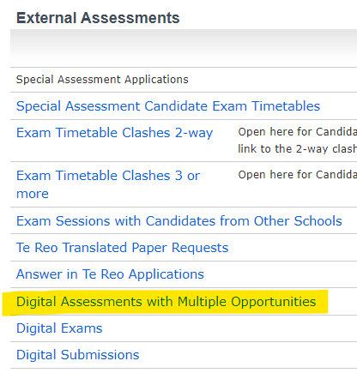
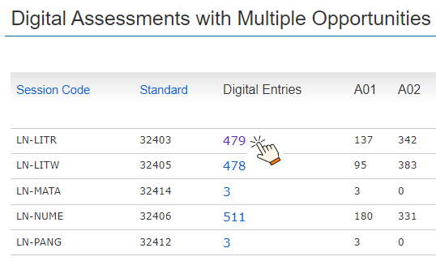
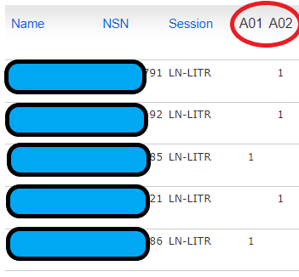
Accurate entries [continued]
Check your entries are correct through the Key Indicators report ‘Digital Assessments with Multiple Opportunities’

Slide 9
Accurate entries [continued]
For late entries close to the assessment start date (e.g. less than two weeks):
there is no way to speed this up
submit entries as soon as possible and in your usual way
check for warnings and errors under ‘Data File Submission’
once processed, check that entries are in the correct folder in Assessment Master (AM)
If a late entry is not processed in time, consider:
assessing them later in the two-week window
waiting till the next assessment event in Term 3
doing on paper as a better option for that student

Slide 10
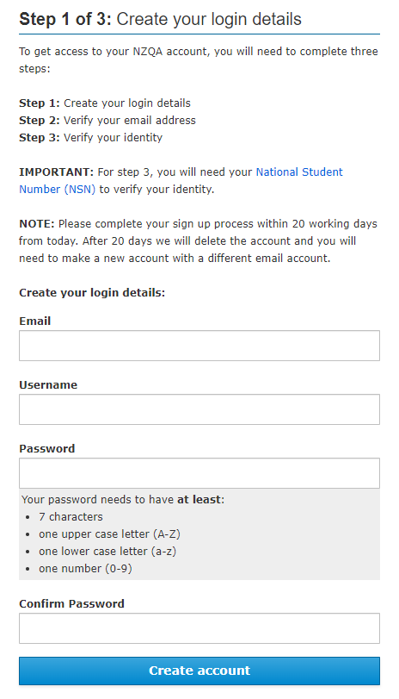
MyNZQA learner accounts setup
To access digital external assessments, a student needs a MyNZQA learner account. Direct them to the NZQA website to create an account.
See ‘Resources for Principal’s Nominee’ for a powerpoint for students.
Younger students (e.g. Year 10) could use their school email as their username so if they forget their password, you’ll know where the reset will get sent to. (They can change it to an external email address when they are a senior.)
NZQA must have received and processed at least one NCEA entry for a student before they can complete the MyNZQA learner account verification using their NSN.

Slide 11
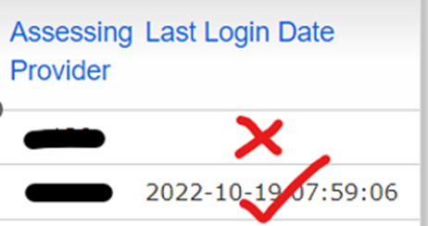
MyNZQA learner accounts setup [continued]
Ensure that students have an active MyNZQA learner account.
Check this by logging into your NZQA Provider account then:
go to the Key Indicators report
scroll down and click on 'Digital Assessments with Multiple Opportunities’
when you click on the blue number in the Digital Entries column, you will see a list of students who have been entered to do that standard digitally
Check the ‘Last Login Date’ column (sortable by clicking the column header)
Students with a date have an active learner account
Students without a date still need to create one

Slide 12
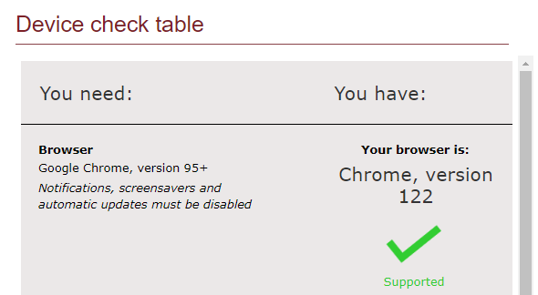
Student preparation
To be prepared, students need to:
have an active MyNZQA learner account (see previous two slides)
use a suitable device that is connected to the internet through the school’s network
check device setup using this link
NZQA does not test all device types. If a device does not meet the requirements on the ‘digital exams device check’ page, you can do a past digital external assessment to check functionality and suitability.

Slide 13
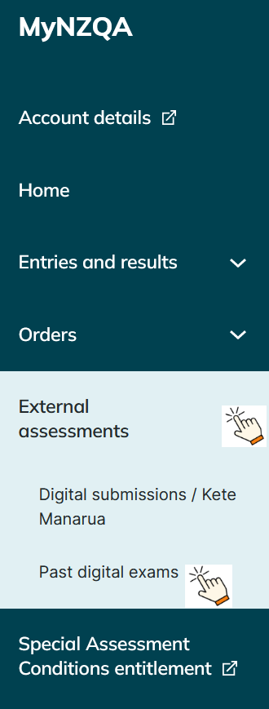
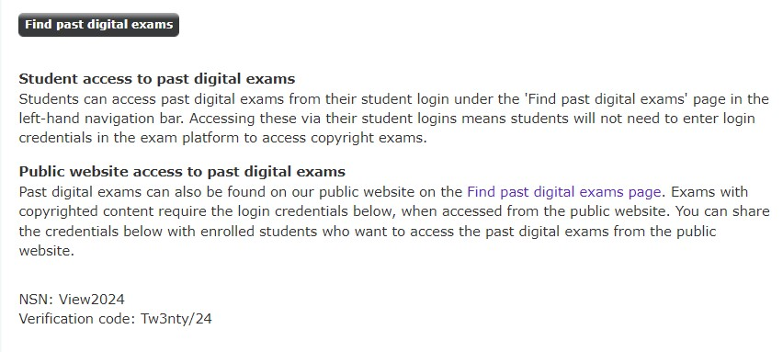
Student preparation [continued]
do past digital assessments to become familiar with the platform (via their MyNZQA account -> select ‘Past digital exams’)
students access actual online assessments via a student log in link on the NZQA website – NOT their MyNZQA account [See the slide ‘6. Technical Preparation’]
If a student doesn’t yet have an account, they can access past assessments via the ‘Public website’ method outlined in your Provider login.

Slide 14
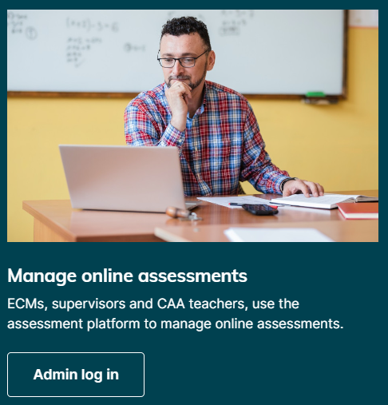
Assessment Master (AM)
The PN will be emailed login credentials for AM (if there are entries) and instructions from assessment.service.centre@nzqa.school.nz three weeks before the assessment event
To access AM, Administrators and Supervisors go to the NZQA website Login page and scroll down to the ‘Admin log in’ button
Once the PN has activated their Administrator login, they can setup Supervisor logins. Note that any password resets will go to the email address used for the Administrator login. The PN can setup Supervisor logins and give them out.
Administrator – unlock/lock assessments, create and allocate rooms through ‘Bulk Update’ and all Supervisor functions
Supervisors – see ‘Access Codes’, monitor activity, resolve lock-outs and check status to submit on behalf of student if necessary
Email assessment.service.centre@nzqa.govt.nz for any issues with logging into AM

Slide 15
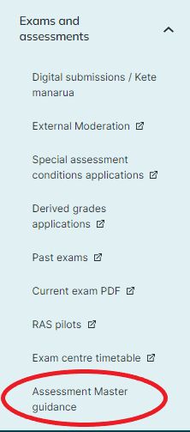
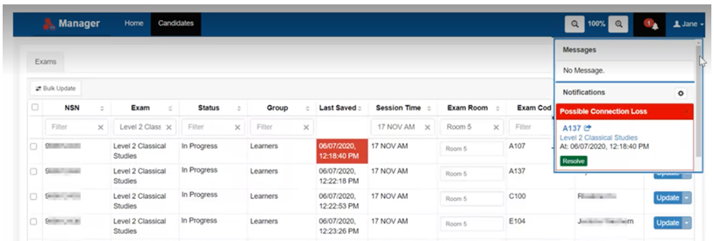
Assessment Master (AM) [continued]
Familiarise yourself with AM by:
reading the full guides and reduced job aids located under “Assessment Master guidance” in the new portal
doing the Digital Assessments training module in Pūtake – NZQA’s Learning Management System. If you can’t login to Pūtake then check with your school’s Education Sector Login (ESL) Delegated Authoriser to have the necessary permission added.
Learn how to do tasks like:
unlock an assessment
find the 4-digit access codes
change the status of a student who gets locked out
allocate rooming

Slide 16
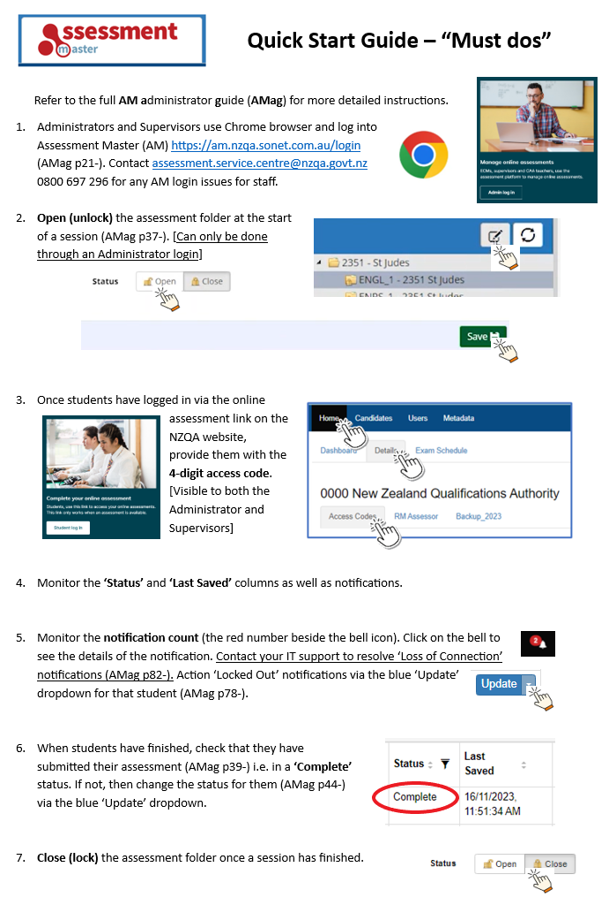
Assessment Master (AM) [continued]
Quick Start Guide for staff:
Use Chrome and login to AM
Unlock the assessment
Provide students with 4-digit access code
Monitor activity
Action notifications
Check for Complete status
Lock the assessment
Note that AM auto-saves work regularly if the device is continually connected to the server. The supervisor will get a notification if the student is disconnected i.e. their work is no longer being saved.

Slide 17
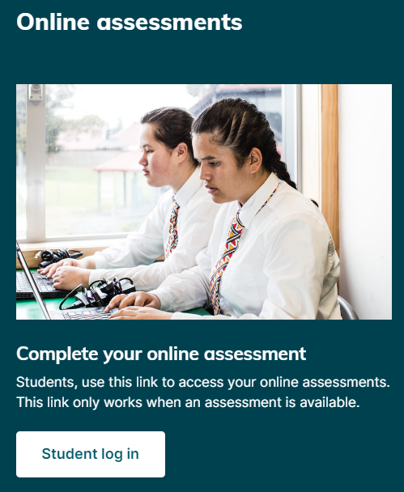
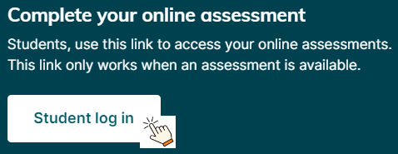
Technical preparation
Make sure your school has suitable infrastructure.
Get your IT support to check your school’s technology
Suitable rooming – large venues are fine if you have suitable staff and organization. A separate room(s) for students with SAC works well. Note that students don’t have to do the assessment at the same time. The same day for Writing is the preference though.
Check school device suitability
The online assessment link works if:
an assessment is available
the student has a MyNZQA learner account
the student has been entered into the correct standard, method and opportunity
On the day of the assessment:
students access assessments via the link on the NZQA website NOT via their MyNZQA account
scroll down the Login page and click on the white ‘Student log in’ button and use their NZQA login credentials
make sure devices are fully charged and have notifications, updates and screensaver disabled

Slide 18
Contingency plans
Have plans in place in case unexpected events happen.
Ensure that your ICT support is available
Be organised:
Administrator ready to unlock assessment
Access Codes ready
Staff to help with student login issues (password reset if they know the email address used for their account OR use the backup URL and verification codes if they don’t)
Have paper copies of the AM Job Aids and the Quick Start Guide
Have some fully charged spare devices available
In addition to paper copies for SAC students, have some more copies for low numbers of possible disruptions. PDF downloads available 3:30pm the day before via Provider login.
Consider what to do if there was a large-scale disruption, e.g. power outage - delay till later in the day or reschedule to another day
For help, contact your SRM or NZQA Contact Centre priority LIT NUM TRM TP line 0800 222 230

