Slide 1
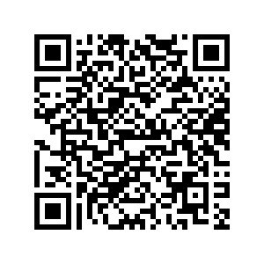
Find the LNA Seminar handbook in your email, or in the PN resources on the NZQA website, or use the QR code

Slide 2
Leading National Assessment Seminar
School Quality Assurance and Support
February – March 2025

Slide 3
Welcome
Karakia
Housekeeping
Whakawhanaungatanga

Slide 4
Agenda
8.45 NCEA updates - reviewed standards
Level 1 NCEA 2024 – 2025
Co-requisite transition and quality assurance process
9.30 Authenticity and Generative Artificial Intelligence
Strengthening internal and external moderation
10.30 Morning tea
11.00 Quality data
The role of the Principal’s Nominee
External assessment and communication processes
12.30 Evaluation and finish

Slide 5
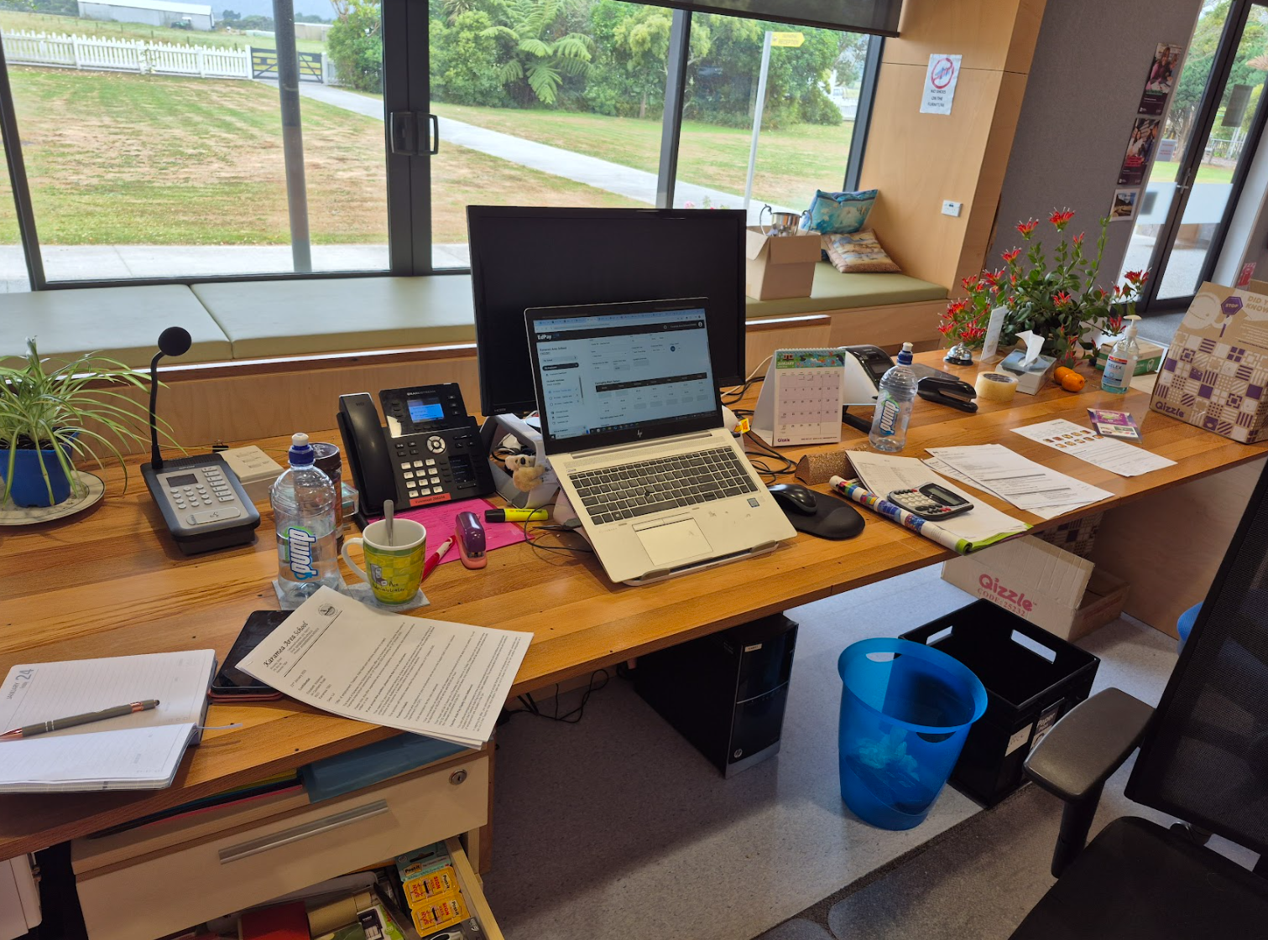
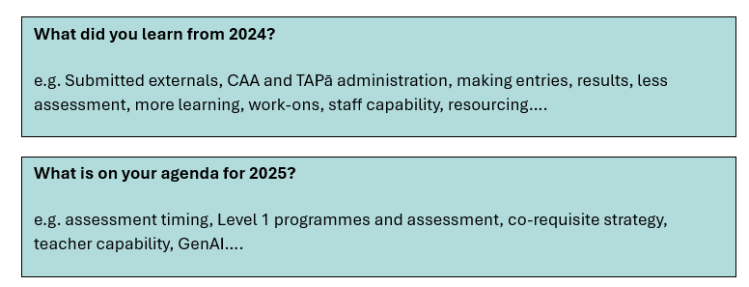
NCEA in 2025
What did you learn from 2024?
What is on your agenda for 2025?

Slide 6
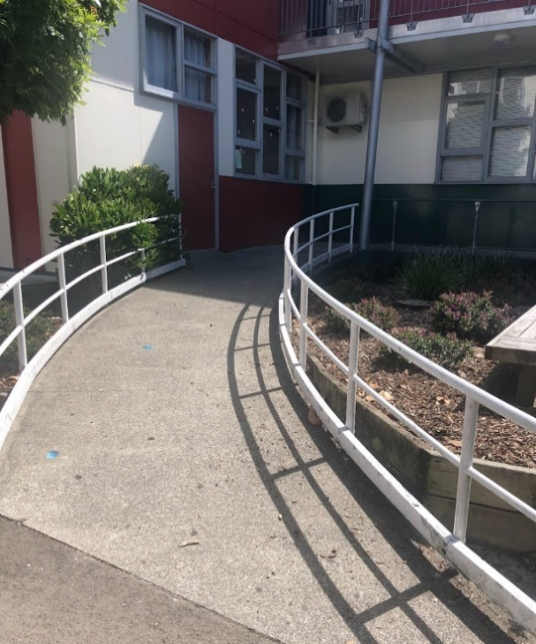
RAMP standards – not just Level 1
Most of the updates are minor and have been made to improve clarity and interpretation.
Some are due to the removal of submitted reports as a method of external assessment in Level 1 from 2025.
Refer to the Appendices – revised Internal Assessment, and all External Assessment
Supporting material includes: Unpacking the Standard, Conditions of Assessment, Internal Assessment Activities and their assessment schedules, Course Outlines, Subject Learning Outcomes, and External Assessment Specifications and sample assessment items.

Slide 7
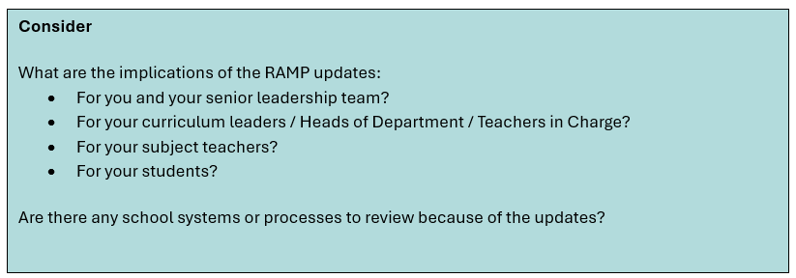
RAMP standards – not just Level 1

Slide 8
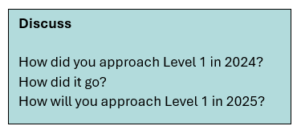
2024 Level One NCEA – the data
In 2024, 155 schools did not offer at least 80 credits to their Level 1 students. That means 356 did.
Notes:
Full programme is 80 + credits

Slide 9
Co-requisite requirement
The transition period for the implementation of the NCEA co-requisite has been extended to the end of 2027.
Check whether alternative standards are eligible, and whether students are eligible to use those standards: Literacy and numeracy assessment standards.
Co-requisite administration payment to schools.
New Process for 2025: Quality Assurance of delivery of CAAs & TAPā by SRMs.

Slide 10
Strengthening Credible Assessment – Authenticity and Generative Artificial Intelligence
What we learned from the Submitted Report externals
Changes in methods of assessment needed in order to support schools and teachers and address authenticity concerns.
More certainty needed for teachers and students on acceptable use of technology.
Schools must have an authenticity policy
Acceptable use of GenAI.
Academic integrity.
What evidence of authenticity looks like.

Slide 11
Authenticity and Generative Artificial Intelligence
Discuss
What did you learn from the 2024 submitted reports that could apply to internal assessment and/or DG exams and/or external assessment in your school?
How alive and well is academic integrity in your student body? Across your staff? How do you know?
How confident are you about the way each subject area manages authenticity? What is that level of confidence based on?
How do you document Breaches of Authenticity and monitor them to ensure consistent practice across all learning areas?

Slide 12
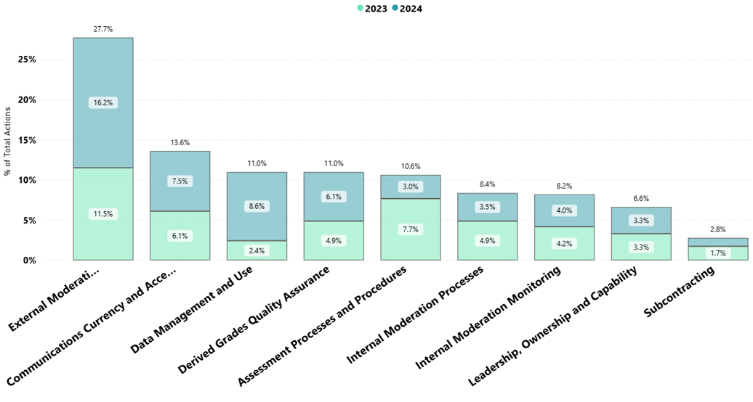
Managing National Assessment reviews – 2024 feedback
How effectively does your school ensure the credibility of assessment for national qualifications?

Slide 13
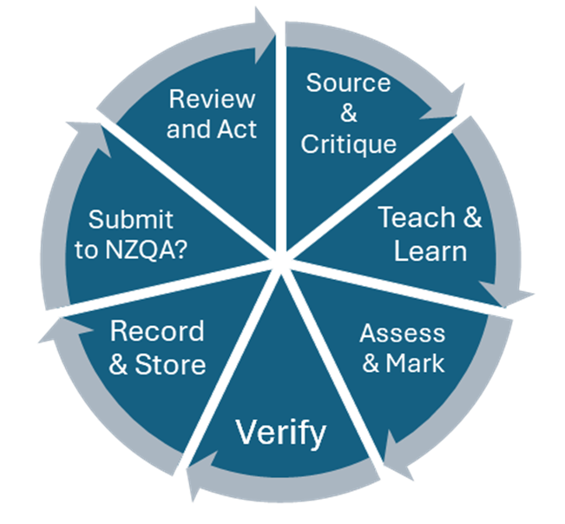
Strengthening Internal Moderation
Maintaining quality assurance processes to ensure that:
Assessment material is critiqued before use​.
Judgements are consistent with the standard​.
Judgements are verified by another teacher​.
Materials retained for external moderation​, benchmarking and exemplars.
Advice from external moderation is acted on before assessing the standard again.
Review and improve systems and processes
Everything must be able to be checked, and completed before results are reported.

Slide 14
External moderation 2025
Moderation Focus:
Level 1 standards remain the focus.
Level 2 & 3 standards will be selected to ensure coverage.
Samples must be from 2025 assessments.
Important Reminders:
Appeals and queries must be submitted within 20 working days.
Ensure moderation plan is updated and communicated to staff.

Slide 15
Paramanawa Morning Tea
I question this picture

Slide 16
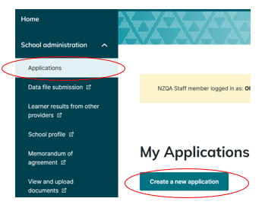
Quality Data - New Process for Subcontracting Arrangements
Every MoU and application to use an unconsented third party must be made in the Applications section of the new portal.
Who will check and upload the MOUs for your school / kura?
Note: This process is not currently available and we will let schools know when it is

Slide 17
Quality Data – your SMS data submission files
Accurate data means less work for you, better tracking of student progress, and staff accountability.
Activity: Match the common errors and warnings from 2024

Slide 18
Principal’s Nominee: Functions, Skills and Attributes
Discuss:
How are Leadership, Quality Assurance, and Administration of assessment covered within your school?
Consider joining the Aotearoa New Zealand Principal’s Nominee Network – email anzpnn@gmail.com
Activity:
Annotate the PN Accountabilities table with the codes of your people.
Indicate which ones you might need to discuss further with your colleagues at school.
Is there anything you think should be added? Ticked differently?

Slide 19
Strengthening external assessment
New derived grade application submission tool
Will pull submitted grades into the application.
Will make it easier and quicker to submit applications.
Working with your Exam Centre Manager during the year
Review of 2024 external exams.
Roles and responsibilities of the PN and ECM - a strong working relationship.
Review:
What went well during the 2024 EOY NCEA Exams?
What were the pressure points?
What could you do to strengthen external assessment practice in your school / kura?

Slide 20
Managing your NCEA assessment calendar
Calendar notes – plan for these early:
Co-requisite CAA and TAPā assessment event 1 entries are due in your 1 April data file.
Co-requisite CAA and TAPā assessment event 2 entries are due by 18 August.
External moderation must be submitted for each requested standard as soon as the internal assessment process is complete.
Grades from school practice exams for use as potential Derived Grades should be reported to NZQA before external exams begin.
Personalise the 2025 template to suit you.

Slide 21
Strengthening Communications
Document school assessment policies and procedures.
Review and update frequently.
Ensure method of communication is fit for purpose.
Review your process templates – e.g. Appeals, Extensions, Authenticity.
Use the Myths to help build teacher capability.
Consider / Discuss
Who else is familiar with your handbooks / intranet / website information?
How and where do your staff and students find out what to do?
Share good practice.

Slide 22
Reminders for new and seasoned Principal’s Nominees
Special Assessment Conditions (SAC) notification process.
EmaiLink lives in Publications on the NZQA Website.
Assessment Matters lives in Publications too - important updates.
Check ncea.education.govt.nz for NCEA updates from the Ministry of Education.
Online SQAS support sessions – see Appendix.

Slide 24
Kia ora koutou Thank you
www.nzqa.govt.nz

