Slide 1
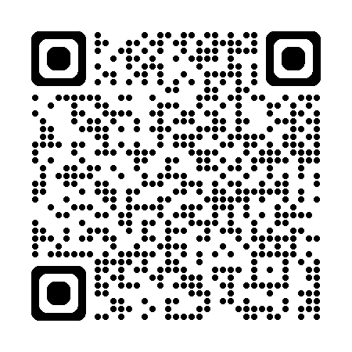
Find the LNA Seminar handbook in your email, or in the PN resources on the NZQA website

Slide 2
Leading National Assessment Seminar
School Quality Assurance and Support
February – March 2026

Slide 3

Agenda
8.45 NCEA updates – reviewed standards
NZQA updates – assessment and administration
Assessment practice – authenticity and marking
9.30 Quality assurance – intervention framework, moderation practice, Pūtake
Consent to assess – ISBs, MOUs
10.30 Morning tea
11.00 External assessment – SAC, submissions, Derived Grades, Breaches
PN support – webinars, resources, clusters
12.30 Evaluation and finish

Slide 4

Potential Qualification changes
Nearly 11,000 submissions were received during consultation on the proposal to replace the National Certificate of Educational Achievement last year.
As announced by the Minister of Education, a decision on the proposal to replace NCEA is expected to be taken to Cabinet.
Due to the high-level of engagement and some great feedback during the consultation process, the Ministry is expecting to undertake some engagement with key technical groups on specific aspects of the proposal such as qualification design decisions.
12 Feb 2026

Slide 5
Review and Maintenance Programme (RAMP) Updates

Slide 6
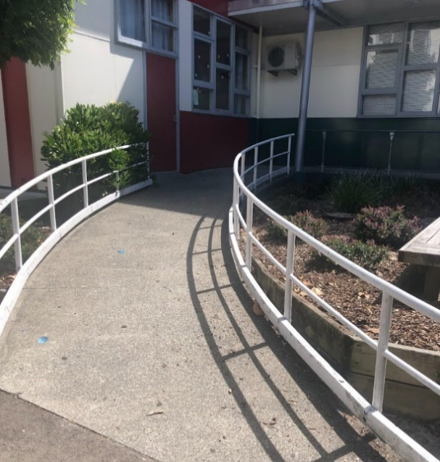
Updates - Review and Maintenance Programme
Updates to
NZC and TMOA standards
Conditions of Assessment for ALL internally assessed standards
Assessment Specifications for some externally assessed standards
Available resources
See the Appendix – from page 63 in the handbook.

Slide 7
Updates - Review and Maintenance Programme
Discuss:
What are the implications of the RAMP updates:
For you and your senior leadership team?
For your curriculum leaders / Heads of Department / Teachers in Charge?
For your subject teachers?
For your ākonga?
Are there any systems or processes you need to review because of the updates?

Slide 8
NZQA Updates

Slide 9
Updates – Assessment Matters in 2025
Important updates to secondary school assessment are communicated through Assessment Matters, emailed to all PNs as needed.
Complete the True / False Quiz on page 8 of the handbook.
Activity – Consider:
What, if anything, did you miss in last year’s Assessment Matters?
What, if anything, do you need to communicate with the relevant staff?
Are there any systems or processes you need to review because of the updates?

Slide 10
Updates and reminders
– the co-requisite assessments
CAAs and TAPā will be held in the same two 2-week assessment windows in 2026:
18 – 29 May, and 7 – 18 September
  All portfolios and kete manarua must be uploaded by 28 October.
  You will not need to advise NZQA of your planned assessment dates for the co-requisite CAAs and TAPā in 2026.
  Reminder: Co-requisite CAAs and TAPā are digital assessments
Activity - Discuss:
What worked well with your co-requisite assessments in 2025?
Are there any systems or processes you need to review before the CAAs and TAPā in 2026?

Slide 11
Administration update – the API
From 2026, all school data will be sent to NZQA by your SMS, using an API.
You no longer have to upload data files to NZQA with entries and/or results.
Error messages will appear in your SMS, not in your NZQA login.
Read the key questions and answers on page 14 of the handbook.
Activity - Consider and discuss:
What are the implications of the API for how you manage entries and results?
What questions do you have for your SMS provider?
What questions do you have about data management in general?

Slide 12
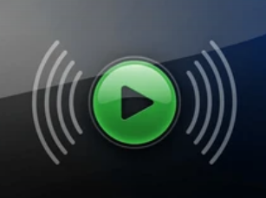
Polly 2026 Text-to-Speech Trial
Expressions of Interest

Slide 13
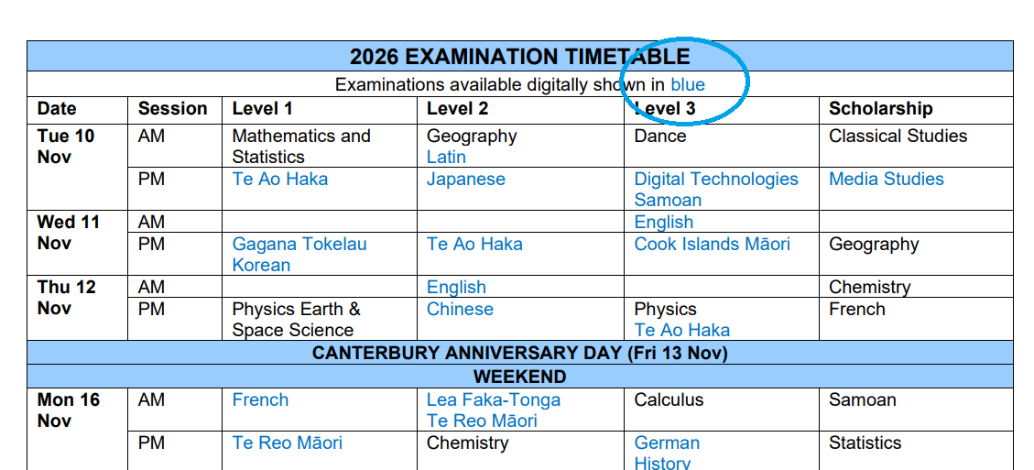
Digital-by-default examinations
Level 1 digital examinations are designed to be completed digitally.
The expectation is that a clear decision-making process is undertaken before ākonga are entered for paper-based examinations in 2026.
Discuss:
Does each of your ākonga have the option of completing digital examinations?
Who decides, and how?
How might you adapt the example guidelines?

Slide 14
Assessment Practice

Slide 15
Authenticity and the Conditions of Assessment
The Conditions of Assessment (COA) across all Level 1 internally assessed standards have been updated to include clearer guidance about authenticity.
What evidence has the student shown you that their work is their own?
Activity:
Underline what’s new
Highlight what you will need to monitor
Circle anything to add to your staff and/or student assessment communications
Asterisk* what you need to discuss with your middle leaders.

Slide 16
Authenticity and the Conditions of Assessment
Discuss with your group:
How has your Authenticity and GenAI policy changed over the last year?
What tools or practices would you recommend to others?
What will you review or do differently in 2026?

Slide 17

Guidance for Marking - How do you mark?
Internal assessment: Bottom-Up, Holistic
External assessment: Top-Down
Consider:
How might you use these resources to strengthen teachers’ understanding of marking, and therefore accurate judgements?

Slide 18
Quality Assurance

Slide 19

Quality Assurance - Intervention Framework
Te Ara Tukutuku clarifies how the School Quality Assurance and Support team will work with schools and kura to understand and deliver “What Good Looks Like.”
You can expect:
MNAs, Quality Assurance visits, and other checks to continue
That how and when NZQA evaluates practice at your kura may vary, according to:
      Completion of required actions from previous reviews
      Compliance with NZQA policies, processes and procedures
      Concerns arising between reviews
      Your particular context and support requirements.

Slide 20
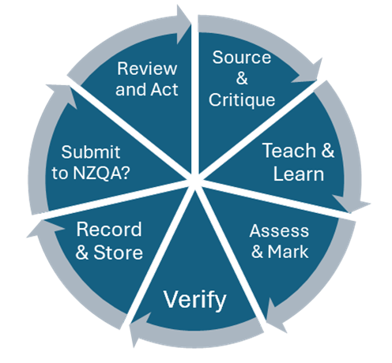
Quality Assurance – Moderation Practice
Monitor that all the steps have been completed effectively.
This year, for external moderation:
    Submit it efficiently
    Follow up feedback effectively
    Act on any requests for submitting and following up confirmatory moderation.
  Consider:
  Does the confirmatory moderation process make you think of any subject areas that need to improve their practices?
  If so, what could you do within your kura to support more accurate marking?

Slide 21
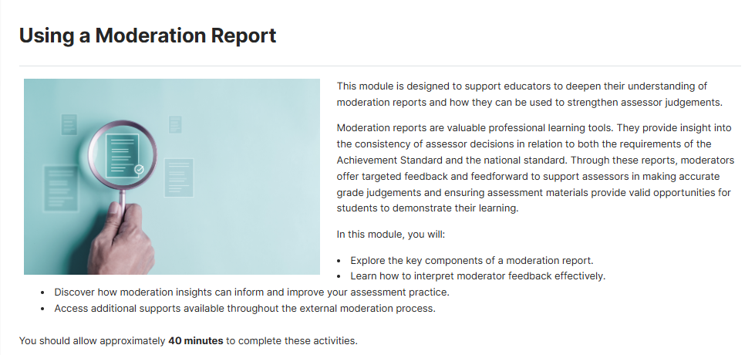
Quality Assurance – Pūtake courses
Discuss:
What have you done in Pūtake?
What have your teachers done?
How are you encouraging teachers to access these resources?

Slide 22
Consent to Assess

Slide 23

Extension of Consent – Industry Skills Boards
Eight Industry Skills Boards (ISBs) began operating in January 2026, replacing Workforce Development Councils (WDCs).
Use the usual process to apply to extend your consent to assess, via Applications in the old portal.
Contact the relevant ISB for an endorsement letter.

Slide 24
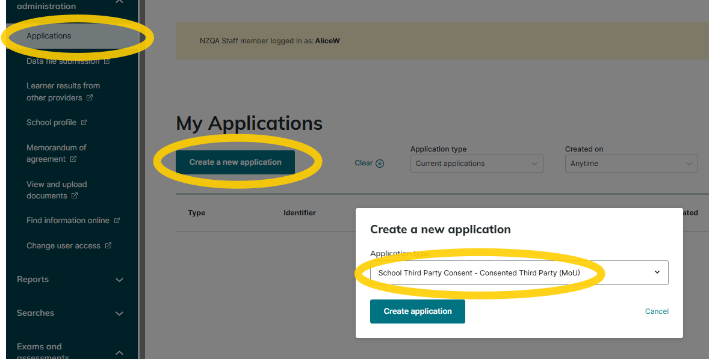
Memoranda of Understanding - MOUs
Don’t use an external provider unless you have an MOU.
Upload all your MOUs with consented external providers to NZQA.
If it’s complicated, ask NZQA.

Slide 25
Paramanawa
Morning Tea
I question this picture

Slide 26
External Assessment

Slide 27

Special Assessment Conditions
The Notifications Gateway may be used for all Year 11-13 ākonga – collect the evidence.
The Approvals Gateway may still be used to confirm provisions – submit the evidence.
Keep all evidence, and submit it for auditing if required
Attach SAC to entries before 1 September.
Consider:
What is your SAC evidence?
Where is your SAC evidence?

Slide 28
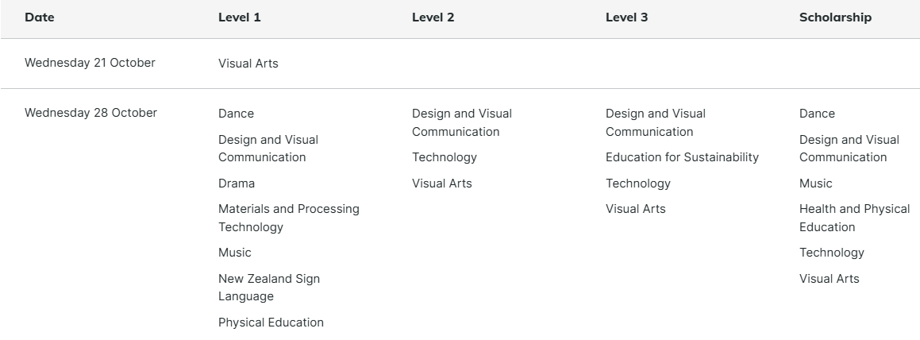
Submitted Externals
Now due
2 November
Check that everything has been submitted correctly, so that the work can be marked.
Notes: Level 1 and Level 2 Visual Art must be submitted digitally.
Level 3 Visual Art is now due on 2 November.

Slide 29

Derived Grades
  The Derived Grade process is for when ākonga are prevented from completing an exam or performing at their best by reasons beyond their control on the day of the exam
  Decisions are based on evidence, not emotion
  Ākonga must take responsibility for things within their control
  National representation can be pre-approved
  For Derived Grades at Scale, student-specific evidence of the impact of the event is needed.
  Activity: Would you approve the DG application?

Slide 30
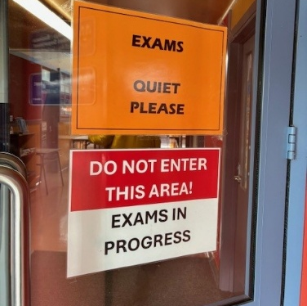
External Assessment Quality Assurance audits
School Relationship Managers complete Quality Assurance audits during co-requisite assessment events and examinations.
Expect a visit within 3-5 years, or sooner if we have concerns.
We will send you a report that outlines good practice, and any issues identified in preparing, carrying out, or completing effective external assessment at your school.

Slide 31

Preventing Breaches of Assessment Rules
Ākonga are less likely to breach the assessment rules when expectations are clear, the assessment rooms are settled, and supervisors are vigilant.
  Grammarly and other GenAI tools are not allowed in external assessments.
Activity: Consider
How much do you and your teachers know about the use of Gen AI tools by your ākonga? (ChatGPT, Grammarly, translation tools…?)
How much do you and your teachers know about how your ākonga access these tools? (browser extensions, downloaded apps, websites, VPNs)
What do you need to know / learn / communicate / discuss / review?
This Photo by Unknown Author is licensed under CC BY

Slide 32
Breaches of Assessment Rules
Type of Breach | Description | Action
School Breaches | A teacher/exam centre contractor jeopardises the validity of the assessment | Follow the admin guides Work with your School Relationship Manager CAA – don’t let the students back into an assessment later in the day/week
Submitted Work | Students complete work in class, which is uploaded on NZQA’s website. | Teacher check for authenticity Use document checkpoints Use current assessment specifications

Slide 33
Preventing Breaches of Assessment Rules
Activity: Read ‘How to help prevent breaches of the assessment rules in external assessments’
Highlight anything that you need to emphasise at your kura
  Before the next co-requisite assessments
  Before the next school derived grade exams
  Before the next external exams.
Activity: Discuss one or two “Stop the Breach” scenarios at your table.
  Is it a breach risk?
  What should the PN do at the time?
  What should happen next?
This Photo by Unknown Author is licensed under CC BY

Slide 34
Support for PNs

Slide 35
Term 1 webinars listed below
Principal’s Nominees carry significant responsibilities in a complex role.
Much of the work follows an annual cycle, with similar tasks arising at predictable times throughout each year.
To support consistency, and make your workload more manageable, we provide regular webinars designed to help you stay informed and prepared.
Content | Audience
Term 1 PN priorities | PN
Term 1 Kura PN priorities | PN
Leading National Assessment seminar – Online | If you missed the in-person LNA
Special Assessment Conditions (SAC) | SENCO & PN
Data & entries Q&A | PN Data Manager
Literacy & Numeracy and Te Reo Matatini me Te Pāngarau | CAA & TAPā responsibility

Slide 36
School NZQA Provider Login Access
See Quick Access Guide - access granted by Education Sector Login Authoriser via MoE
High Security User
General Security User
Special Assessment Conditions
Moderation Management
Moderation Processor
Derived Grade
Results entry
Pūtake
Consider / Discuss​
Who should have access to what area?
Do you have a backup plan for access?
​

Slide 37
Your PN network
Resources:
2026 Online PN sessions
Resources for Principals’ Nominees
Pūtake (NZQA’s Learning Management System)
Myths about NCEA Assessment The Myths have been updated for clarity. Check them against your school assessment policies and practices.
People:
  SRM
  PN Facebook
  ANZPNN
  Other PNs
Clusters:
  Regional – Are you keen?
  Can you organise?

Slide 38
PN Reminders
Special Assessment Conditions (SAC) notification process
EmaiLink lives in Publications on the NZQA Website
Assessment Matters lives in Publications too - important updates
Check ncea.education.govt.nz for NCEA updates from the Ministry of Education
Consider joining the Aotearoa New Zealand Principal’s Nominee Network anzpnn@gmail.com

Slide 39
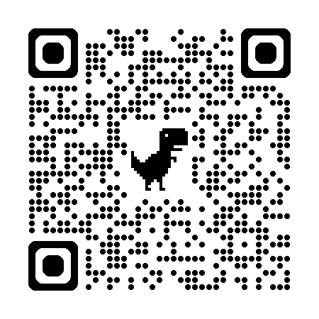
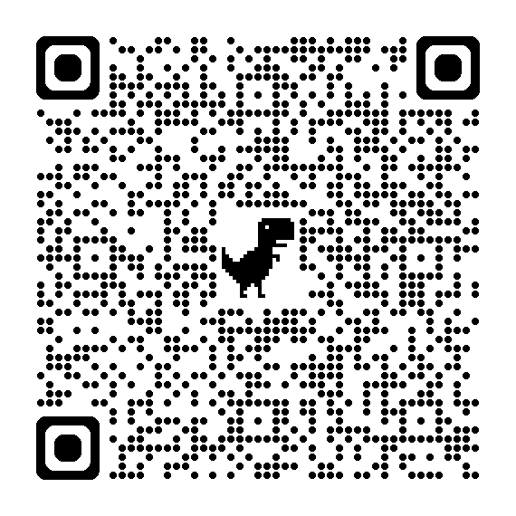
NZQA annual school survey
LNA seminar evaluation

Slide 40
Kia ora koutou
Thank you
www.nzqa.govt.nz

