Slide 1
Kaupapa Māori
Kura Leaders
NCEA Seminar
2019

Slide 2
Hōtaka mō te rā
8.45am -10.30am Appropriate Course Design
I want programmes that provide a pathway
Credible Assessment Outcomes
I want valid, verifiable, authentic assessment
10.30am – 10.50am Paramanawa - I want a coffee and muffins
10.50am – 12.30pm Equitable Access to Qualifications
I want opportunity for achievement
Evaluation of Achievement Outcomes
I want feedback that leads to improvement
Kia noho takatu ki tō āmua ao Qualify the Future World

Slide 3
Appropriate Course Design
I want programmes that provide a pathway
Te ara whakamua

Slide 4
What are you interested in doing when you leave school?
Ka mahi au hei kaiwhakatika motokā
Kāore au e mōhio
He kaiwhakaora kararehe taku wawata

Slide 5
Activity
What programmes can you currently offer these ākonga?
What would you ideally be able to offer these ākonga?
What are the barriers that prevent or limit these ideal programmes happening?
How could these barriers be addressed and who can support this?

Slide 6
Has your school got Consent to Assess the standard
you want to assess?
How do I find out if my kura has Consent to Assess a standard?

Slide 7
What if I do not have consent or suitable Kaiako to assess a standard?
Apply for extension to consent if you have a suitable Kaiako, talk to your School Relationship Manager
Use another consented provider with suitable kaiako eg another kura, Te Kura,
Virtual Learning Network, Private Training Organisation, etc
Enter into a subcontracting arrangement

Slide 8
Using another consented provider
A Memorandum of Understanding - He tūmomo whakaaetanga
documents the relationship between the kura and the consented assessor
must be in place before the course starts
where the external provider code is used to report results.

Slide 9
Using a non-consented provider
Subcontracting - He momo whakaaetanga
A relationship between a consented school and a non-consented provider, approved by NZQA.
Contact your School Relationship Manager (SRM) for further information.

Slide 10
Whose Provider Code
Your kura has consent to assess the standard | The external provider has consent to assess the standard | Provider code used
AE | AE | Report result to NZQA with external provider code in line with the MOU
AE | KAO | Apply to NZQA for approval of subcontracting/whakaaetanga arrangement. Kōrero ki tō SRM.
KAO | AE | Report result to NZQA with external provider code in line with the MOU
KAO | KAO | Kāore e taea/Not able to assess

Slide 11
Credible Assessment Outcomes
I want valid, verifiable and authentic assessment
Ko te tika me te pono

Slide 12
Credible Assessment
Valid: based on the criteria of the standard.
Verifiable: by being recorded in a way that allows someone else to judge the evidence.
Authentic: ākonga’s own ideas and understanding.

Slide 13
What’s in your kura kete? Ka tika, ka pono?
Credible assessment

Slide 14
Kura with credible assessment practice
critique all assessment materials prior to use
ensure subject specialists verify sufficient strategically selected samples of kaiako grade judgements
monitor that all assessed standards are internally moderated before results are reported
review assessment materials following feedback.

Slide 15
Kura are confident in their kaiako ability to make assessment decisions consistent with the standard.

Slide 16
Equitable access to qualifications
I want opportunity for achievement
Ko te mana ōrite

Slide 17
Connecting Learning and Assessment
Learning and Assessment Activities at appropriate curriculum/marautanga level
Context
Standards
Evidence Collection

Slide 18
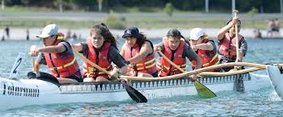
Context for discussion – Waka ama
Identify possible learning and skills development you want to include.
Identify possible standards to assess students against/collect evidence for.
How are you going to collect the evidence?

Slide 19
Contextualised Learning and Assessment
uses kaupapa Māori activities to gather evidence of assessment
recognises the local curriculum of the kura
validates authentic learning and assessment
can better engage ākonga in assessment
can reduce student workload.

Slide 20
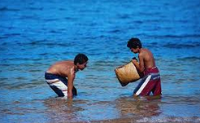
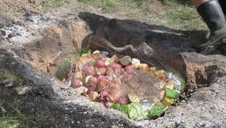
Other kaupapa Māori activities
Use one of these kaupapa to complete the template on page 12
What other activities could you use?
??

Slide 21
Considerations
For the kaiako
Kaiako workload and manageability.
Subject expertise of kaiako and confidence to deliver.
Availability of subject expert for verification.
Learning and assessment resources.
For the ākonga
Workload.
What are the ākonga pathway plans, goals and interests.
Prior skills and knowledge.

Slide 22
Considerations for external assessments
For Kura to apply for:
translated papers
Special Assessment Conditions
Derived Grades

Slide 23
Evaluation of achievement outcomes
I want feedback that leads to improvement
Mā te urupare ka ora ai

Slide 24
Principle: The roles and responsibilities of staff leading assessment for qualifications are reviewed and improvement is made where required.
The Principal’s Nominee
In schools with effective leadership of assessment for qualifications:
the school acts on the principle that all results reported to NZQA must be credible
the Principal’s Nominee takes responsibility for the school’s realisation of this principle
everyone responsible for leading and/or managing assessment systems for national qualifications acts to realise this principle
the role and responsibilities are reviewed and improvement is made where required.
(from the Effective Practice in Schools booklet)

Slide 25
Entries and Results
Accurate and timely submission of entries information and internal results ensures that ākonga can:
gain their qualification in January
take their next planned pathway step
receive scholarships they are entitled to
receive the correct examination papers at their examination centre
receive personalised examination papers
receive translated papers.

Slide 26
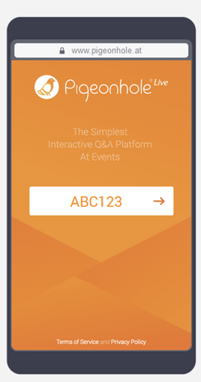
Your thoughts – Whakaaro anō
Using the tool, answer the questions to share your whakaaro on reflection and moving forward.

