Slide 1
Leading
National
Assessment
Seminar
2020

Slide 2
LNA Seminar
NZQA Guiding Principles
Equity
Quality
Innovation

Slide 3
LNA Seminar
Welcome
You can’t go back and change the beginning, but you can start where you are and change the ending.
- C.S Lewis

Slide 4
LNA Seminar
Seminar Programme
8:45am-10:30am | Equity opportunities: STEM Digital Assessment: NCEA Online
10:30am-10:50am | Morning Tea
10:50am-12:30pm | Examinations Using the right provider code International students
Qualify for the Future World | Kia noho takatu ki tō āmua ao

Slide 5
Equality Equity Easy access
LNA Seminar
Equity
EQUALITY | EQUITY | EASY ACCESS
It is assumed everyone will benefit from the same support. They are being treated equally. | Individuals are given different support to make it possible for them to have equal access to the game. They are being treated equitably. | All three individuals can see the game without any supports or accommodations because the cause of the inequity has been addressed. The systemic barrier has been removed.

Slide 6
Equity
This is what you told us - Equity in STEM
The Key Influences
Relationships
What works:
Teachers know student well
Engagement with whānau
High expectations of achievement
Quality teaching and learning
Ethic of care
School-wide Māori and Pacific culture inclusion
Pathways
What works:
Access to next level courses
STEM course planning
Reflective analysis of student achievement data by ethnicity, including future goal setting
Careers guidance

Slide 7
Equity
Reminder of equity ratio
Shows the achievement gap between different groups
Can be used to monitor progress of your school goals towards equity of achievement
Equity Ratio Revisited:
The equity ratio is the percentage of successful students in the target group expressed as a percentage of the successful ‘Other’ Students.
For example, for ethnicity:
Māori Student Achievement
Pacific Student Achievement
Other Student Achievement
Other Student Achievement

Slide 8
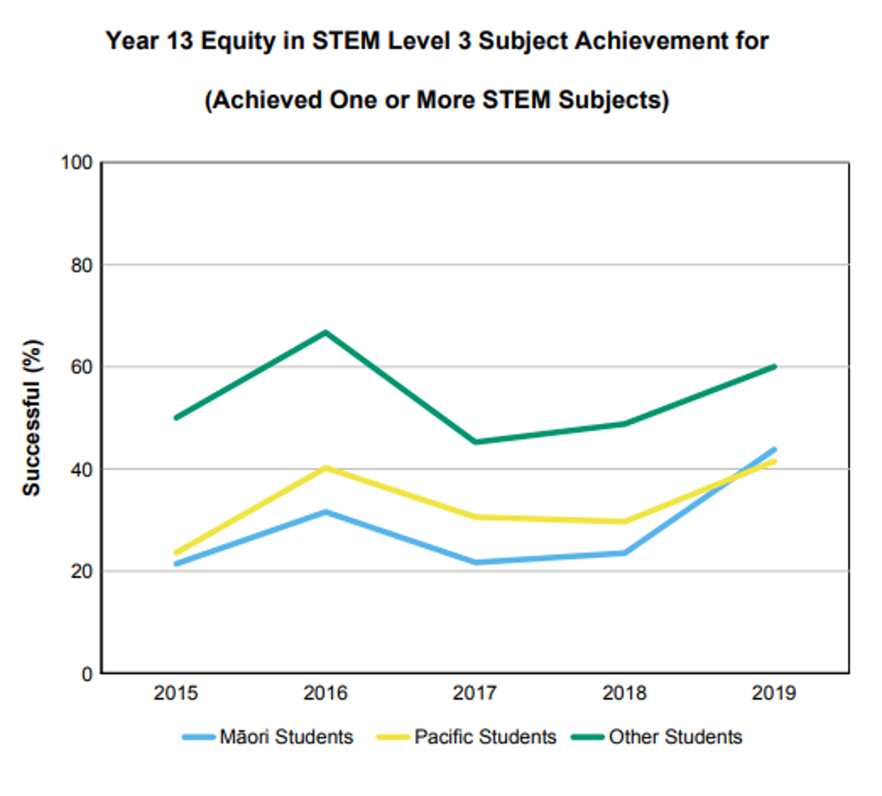
STEM
School A

Slide 9
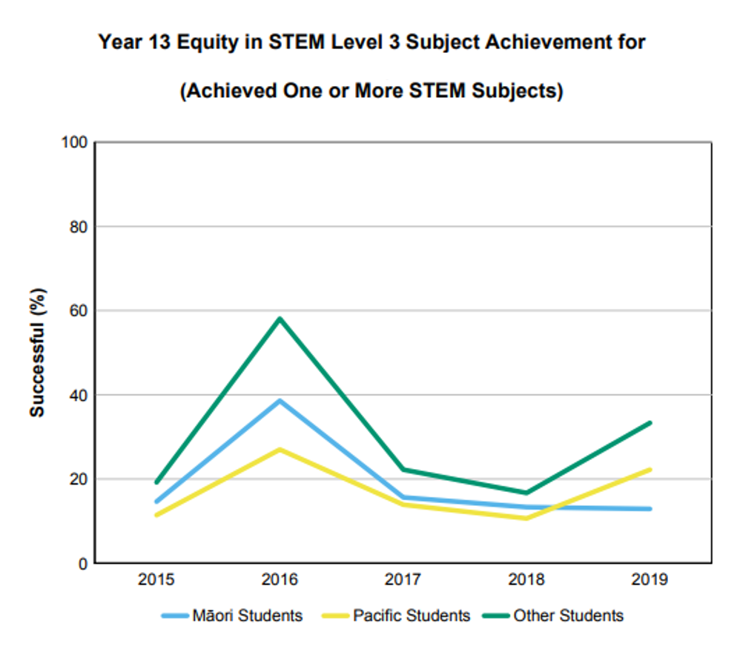
STEM
School B

Slide 10
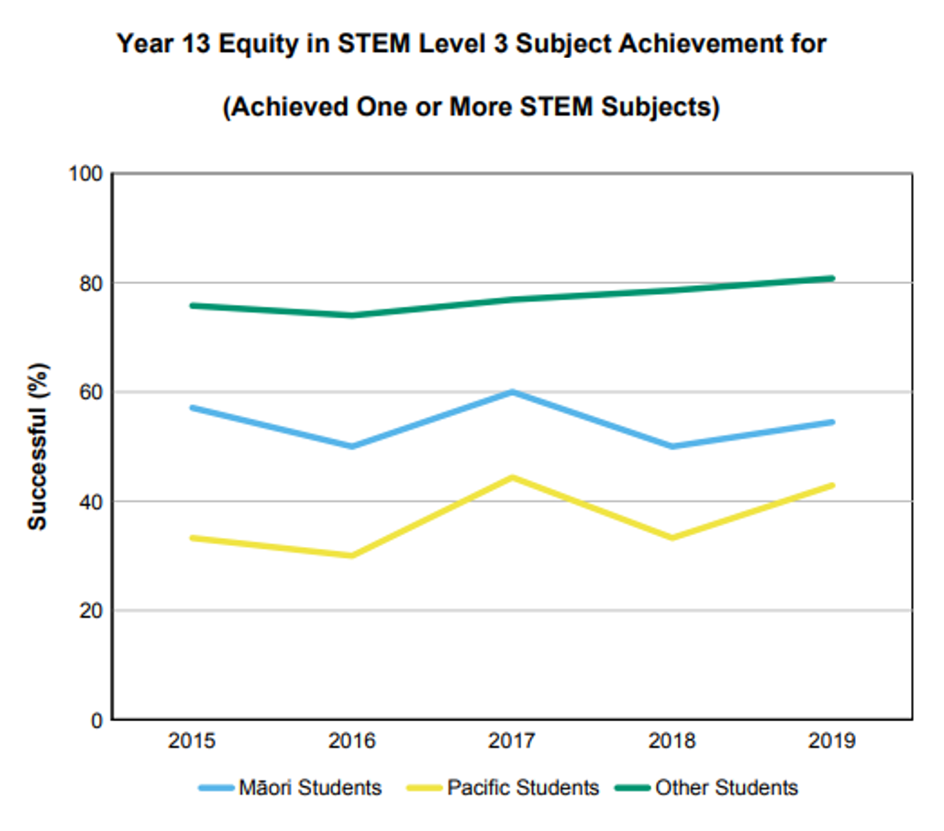
STEM
School C

Slide 12
NCEAOnline
NZQA’s commitment
An assessment experience more relevant to:
learning needs
cultural context, for particularly Māori and Pacific students
Digital exams can:
help us change the way we assess students
provide new ways for students to demonstrate their understanding and knowledge when these exams become the norm

Slide 13
NCEAOnline
2019 in review
Compared with 2018…
4x
Schools
202
3x
Students
14395
4x
Digital exam sessions
35

Slide 14
NCEAOnline
2020 delivery
$2/3$ NCEA exams available digitally
New subjects
More students doing more subjects
Streamlining service delivery and functionality
Practice activities, training and support

Slide 15
NCEAOnline
2020 research focus
Delivering digital exams without internet
Scholarship digital exams
More than one digital external assessment per year
Supporting equity and inclusion through
trialling text to speech in English, and text to speech and spellcheck in Te Reo Māori
using data, evidence and best practice that supports Māori and Pacific participation
Considering using the digital platform to:
assess Mathematics and Statistics, use school SAC software and run practice exams
Marking scanned exam papers

Slide 16
NCEAOnline
Moving forward
NZQA is taking a staged approach to digital exams
We suggest a similar approach for schools
Dip a toe in: start where you can build confidence
Add students and subjects each year
Work with NZQA and N4L for support and preparation
Consider your barriers and what could help

Slide 17
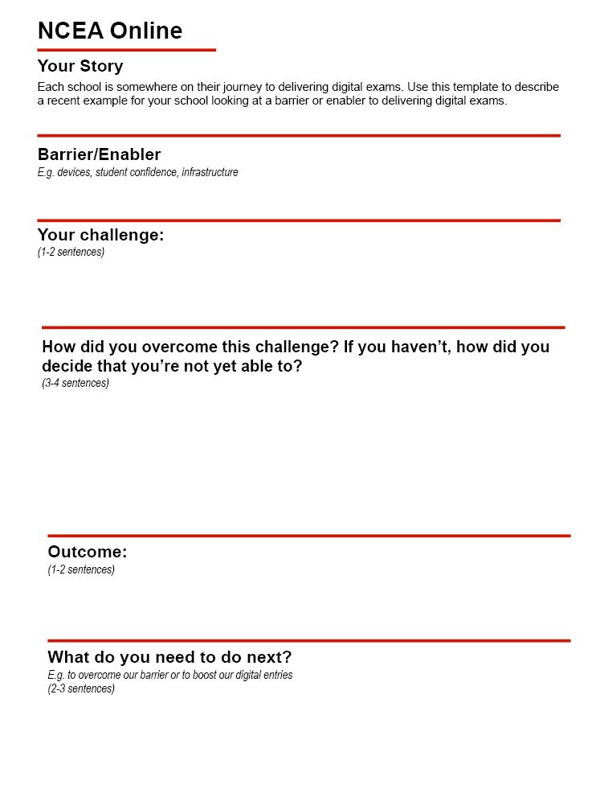
NCEAOnline
Your story
Each school is somewhere on the journey to delivering digital exams
What are your school’s barriers and enablers to delivering digital exams?
Use the template in your handbook to create a story to share

Slide 18
NCEAOnline
Near Star / Far Star
Far Star (for NZQA) – credible assessment and equitable opportunity for all
Near Star - focus for 2020
What are your far and near stars?
What are your next steps to get there?
How can we help?

Slide 19
Examinations
Notification of computer use
For candidates requiring only computer use (no other SAC)
Wherever possible, enter students in digital exams
Notify NZQA via SAC online tool to enable ECM planning
School to consider:
resourcing e.g. access to computers, printers, IT set-up
logistics e.g. rooming, supervisors
exam integrity
parental expectations
Suggest trial in 2020 to match available school resources

Slide 20
Examinations
SAC students entry in digital exams
Recommend:
use the student’s SAC needs analysis to consider the implications
involve students in the decision-making to assist their understanding
prepare students well e.g. use of digital exam platform and practice activities

Slide 21
Examinations
Effective examination preparation
Schools:
support candidates to develop in-depth understanding of learning to:
demonstrate their knowledge and skills well
respond positively to changes in exam papers
use exam techniques effectively
NZQA:
provides resources (exemplars / past papers / assessment schedules) to supplement good teaching
uses self review and feedback to improve questions, formats and resources

Slide 22
Examinations
Assessment Specifications
Reminder:
Updated annually for all subjects and levels (end of year/ March / notified in circular)
Must be checked every year

Slide 23
Using the right provider code
Important because:
3,910,386 internal results reported using school provider code in 2018
Currently
Since 2016
5,300 external MOU relationships with consented providers
8.4% of internal results reported using other provider codes (tertiary and school)
113 approved sub-contract arrangements
101 NZQA investigations
Most investigations involved use of an unconsented provider code
✔

Slide 24
International students
Course approval
For courses exclusively or mainly (> 50%) for international students
To ensure equitable standard of instruction
2019 4E Education Approval Status | Number of schools
All courses approved | 19
Some courses approved | 27
No approval | 44
Refer to Circular A2020/1

Slide 25
International students
Changed processes 4E Education
Now:
part of consent: same programme requirements as Consent to Assess (Rule 2.5 i – v)
one-off brief application stating Consent requirements met
annual attestation
monitor during SRM school visits and MNA review

Slide 26
International students
School responsibilities
Schools:
pay NCEA and Scholarship fees to NZQA
As Code Signatories:
monitor to ensure students:
met Visa requirements eg attendance, academic progress
undertake the educational instruction they are enrolled for
meet other obligations under the Code
Further information will be sent to schools
Refer to Circular A2020/2

