Slide 1
MyNZQA learner account
Using your MyNZQA learner account

Slide 2
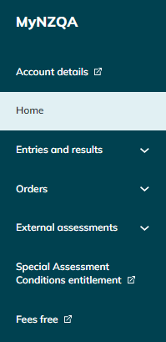
You can use your MyNZQA learner account to:
check your NCEA entries and results
upload digital submissions for marking
request reviews or reconsiderations
order copies of your certificates
print or request your Record of Achievement
update details like your email address

Slide 3
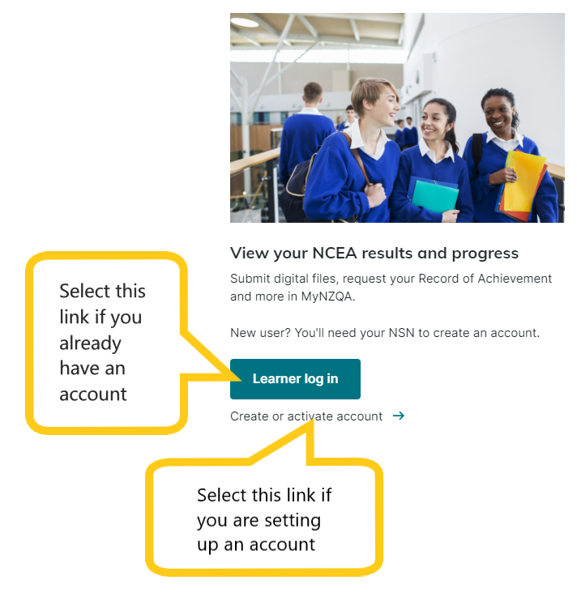
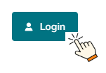
Login or create account
Click on the Login button on the NZQA homepage
https://www2.nzqa.govt.nz/login/

Slide 4
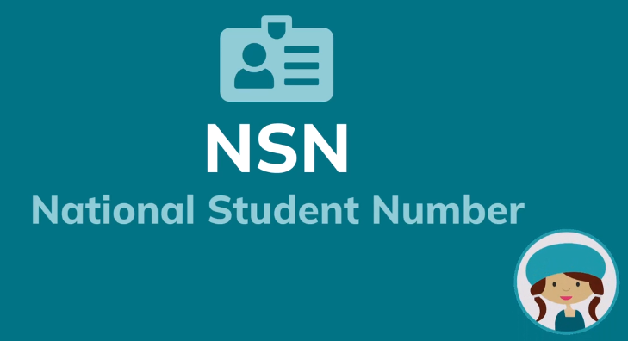
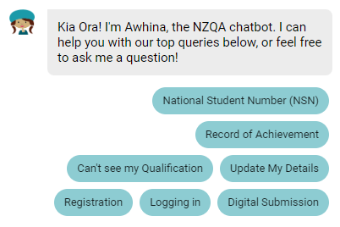
National Student Number (NSN)
If you are creating an account, you will need your NSN to verify your identity (Step 3). This is your personal student number; it will appear on all of your external assessments.
Get your NSN from:
your teachers or
your school online portal or
NZQA Contact Centre 0800 697 296 or
Awhina – NZQA’s chatbot at https://www2.nzqa.govt.nz/
Your NSN is nine digits long e.g. 123456789. You don’t need to put a zero at the start of your NSN if using it to login.

Slide 5
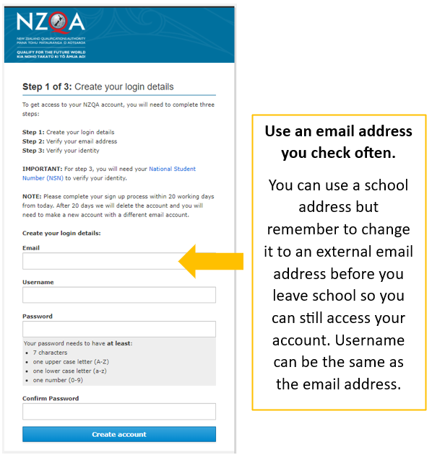
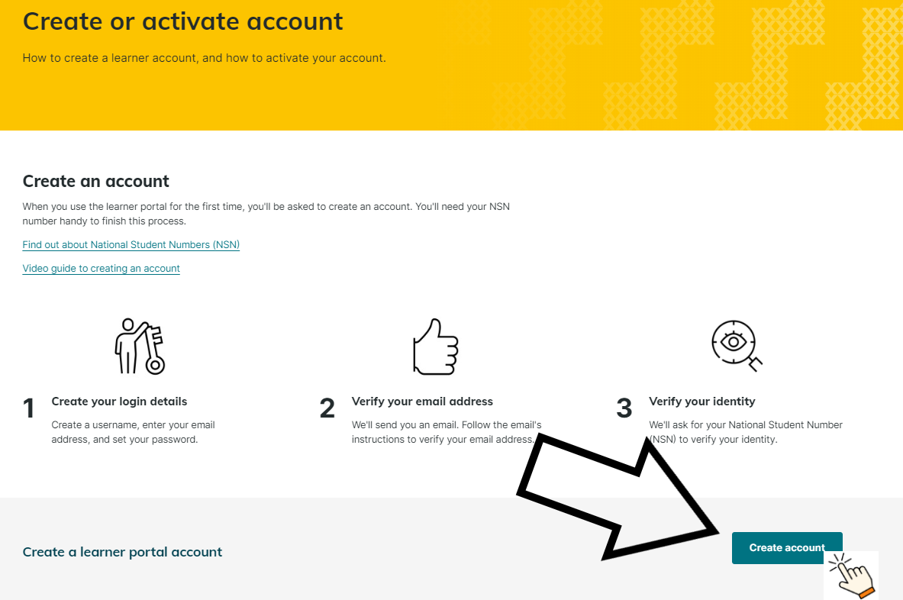
Watch this video on how to create a MyNZQA learner account

Slide 6
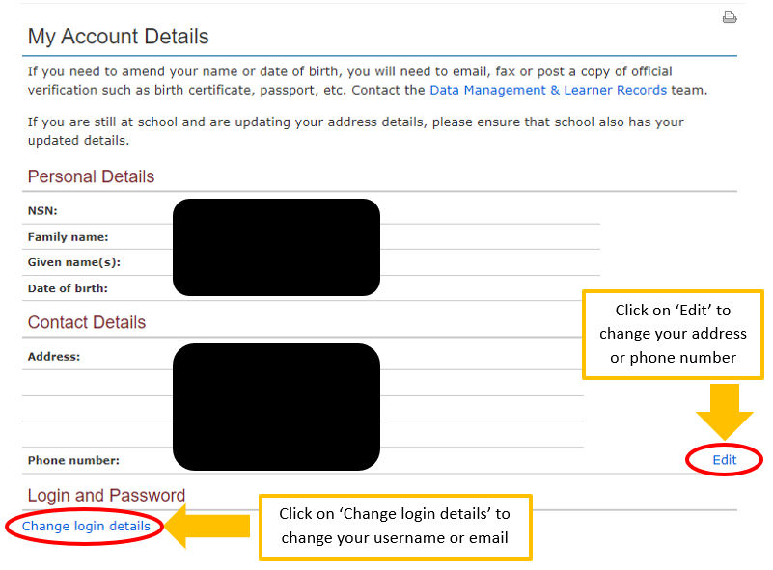
Keep your account details up-to-date
in case NZQA needs to contact you e.g. regarding your results or requests
so you can access your account after you leave school, change your email to an address external to school

Slide 7
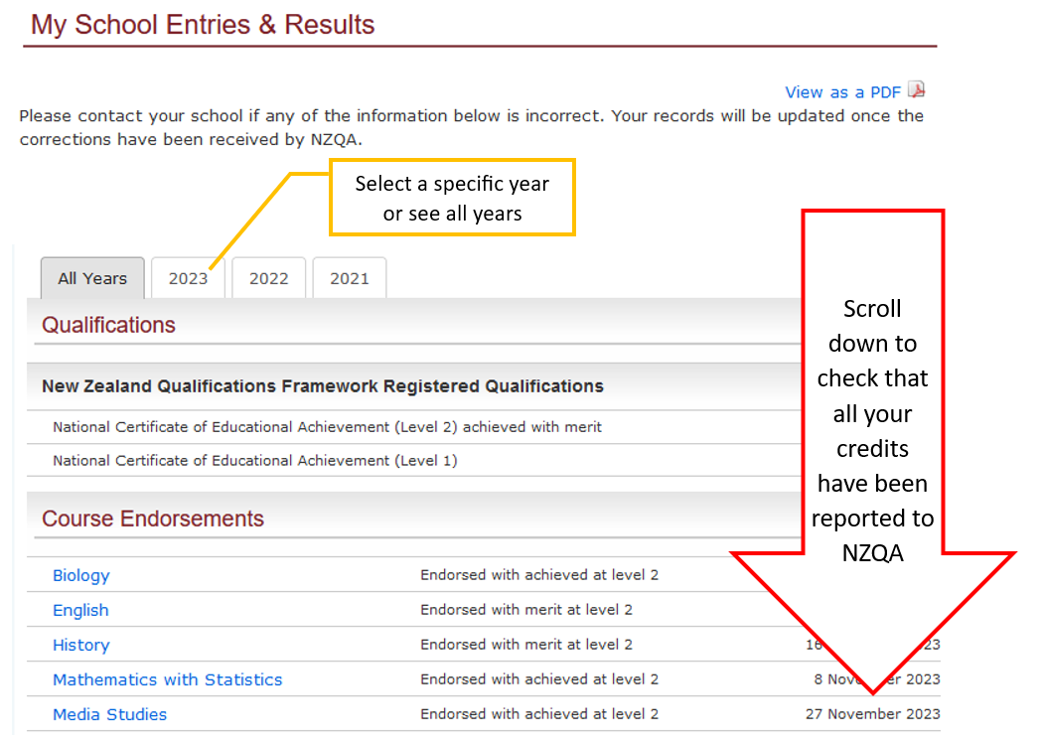
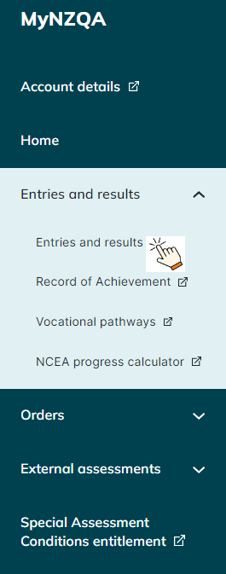
Check your entries and results

Slide 8
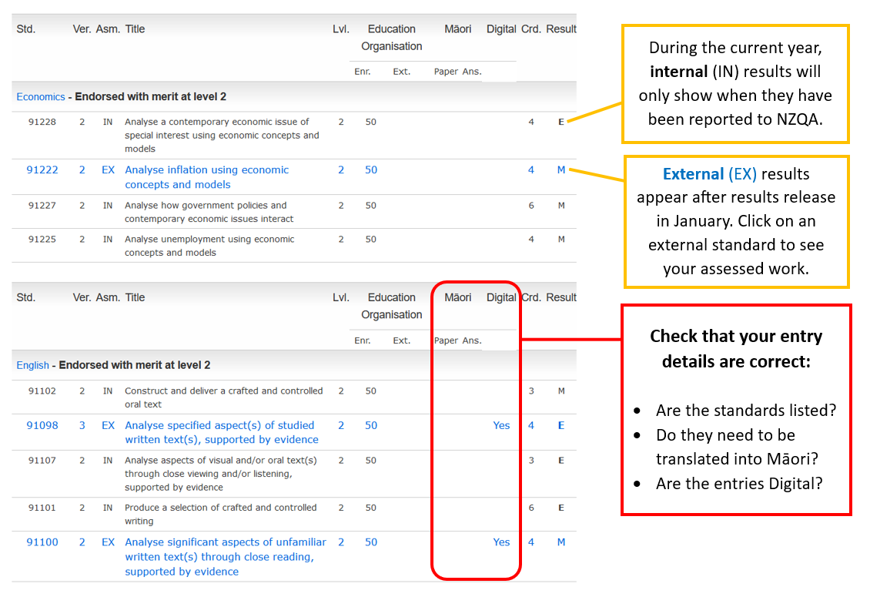
Check your entries and results

Slide 9
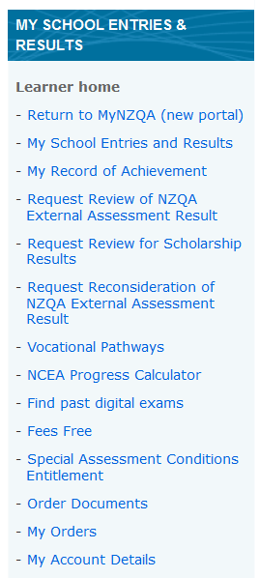
Explore your MyNZQA learner account
Click on the drop-down menus ˅ to see all available options
Sometimes when you click on a menu option or link you will be re-directed to the old portal
old portal
new portal

Slide 10
If you need further help with your Learner account, then please call the Contact Centre on 0800 697 296 or ask Awhina at https://www2.nzqa.govt.nz/
Ngā mihi nui!

